Slide 1
Department of BCA, Project presentation
“ Liver Disease Prediction using Ensemble Technique ”

Slide 2
INDEX :
1.Introduction
2.Project Overview
3.Machine Learning Techniques
4.Project Implementation
5.Performance Analysis
6.Advantages Of the Proposed System
7.Conclusion

Slide 3
What is mean by LIVER?
INTRODUCTION
The liver is a large, vital organ located in the upper right side of the abdomen. It helps in digestion by producing bile. The liver processes nutrients from food and stores energy. It removes toxins and harmful substances from the blood.The liver also helps in blood clotting and fighting infections. It regulates metabolism and hormone levels. A healthy liver is essential for overall body function. Regular exercise, a balanced diet, and staying hydrated help keep the liver functioning well.
Symptoms of liver Disease
Causes of Liver Disease
Jaundice
Fatigue
abdominal pain or swelling
dark urine
loss of appetite
excessive alcohol consumption
hepatitis B and C
non-alcoholic fatty liver disease
certain medications
Obesity and diabetes

Slide 4
LITERATURE SURVEY :
Based on the paper: "Liver Disease Prediction Using Ensemble Technique" (ICACCS 2022)
This study presents a machine learning-based approach for predicting liver disease using ensemble techniques such as Random Forest, XG Boost, and Gradient Boosting. The authors focus on improving prediction accuracy through data preprocessing, feature selection, and model combination. While individual models yielded accuracies around 82–85%, combining Random Forest with Gradient Boosting achieved up to 90.7% accuracy. This approach enhances early detection, aiding clinicians in making accurate diagnoses. The system proves effective for real-world healthcare applications, offering a reliable tool to support decision-making and potentially reduce the impact of chronic liver diseases.

Slide 5
Project Overview :
In recent decades, liver diseases have risen to prominence as one of the world's top causes of death and a condition that can be fatal. According to the WHO, chronic diseases are responsible for over 59 percent of global mortality and 46% of conditions, and they claim the lives of almost 35 million people worldwide. As the liver continues to operate even when partially wounded, problems with the liver are typically not identified until it is too late. Potentially, early discovery can save a person's life.
In the proposed system we implement Liver disease prediction using Ensemble Technique. This system helps to reduce the burden on the doctor by analyzing patient’s conditions using machine learning techniques. Ensemble techniques are models that are created in multiples and then combined to get good results. In most cases, ensemble approaches provide more accurate results than a single model. In short, in this particular technique, multiple algorithms are combined to get a single model out of it

Slide 6
Project Overview :
In our proposed system we use Gradient Boosting Classifier + AdaBoost Classifier (Ensemble Technique). Our goal is to get prediction on the basis of given datasets of people whether the person is having the liver disease symptoms or not. With using Ensemble Technique we are trying to predict the disease. This system will be very useful for many hospitals and even professional doctors to easily detect the disease.
Also, general user can use this system for their finding out the disease. This system will change the way and can be early as possible as it will lead to save the person’s life. This whole work is focused on how we can predict the disease by given datasets so that will help in preventing and curing the disease of the patients

Slide 7
What is mean by Ensemble Technique?
The Proposed system we used Ensemble learning combines multiple machine learning models to build a more accurate and robust prediction system. Instead of relying on a single algorithm, ensemble methods use the “wisdom of multiple models” to make better decisions.
AdaBoost + Gradient Boosting for Liver Disease Prediction In liver disease detection, the goal is to accurately classify whether a patient has liver disease or not based on clinical data (like bilirubin, enzymes, proteins, etc.)…
Here's how these two ensemble methods contribute:
1.AdaBoost(Adaptive Boosting) Focuses on correcting the errors made by previous weak models (usually decision stumps).Assigns more weight to misclassified samples in each round. Good at improving accuracy on simple data. Tends to perform well when outliers and noise are minimal. In liver disease prediction: Can give accuracy around 78–88%.
2.Gradient Boosting Builds trees in a sequential manner by minimizing the prediction error(gradient of loss). Each tree tries to fix the mistakes of the previous ones. More flexible and powerful than AdaBoost, though slower. Works well even with complex, noisy medical data. In liver disease prediction: Can give accuracy around 85–92%.

Slide 8
Why Combine or Compare Both?
Using both AdaBoost and Gradient Boosting helps you: Test which performs better on your dataset. Compare their precision, recall, F1-score (especially important in medical diagnosis).Even stack them for better results (called Stacking Ensemble, optional).
In Brief : "Ensemble techniques like AdaBoost and Gradient Boosting boost the prediction accuracy in liver disease detection by combining multiple weak models into strong learners. While AdaBoost focuses on misclassified samples, Gradient Boosting corrects residual errors. Together, they offer better performance and reliability than single models — with accuracy typically ranging between 80% to 92%."

Slide 9
Accuracy Comparison Table :
Model Type | Algorithm | Accuracy Range(%)
Single Model | Logistic Regression | 70%
 | Decision Tree | 75%
 | K-Nearest Neighbors(KNN) | 73%
 | SVM(Linear/RBF) | 73%
Ensemble(Boosting)
 | AdaBoost | 80-83%
 | Gradient Boosting | ~82%-85%
Hybrid Ensemble(Stacked) | AdaBoost + G Boost | ~92%

Slide 10
Example Workflow in the Liver Disease Model:
1. Data Preparation:
The liver dataset is cleaned, features are selected, and data is split into training and testing.
2. AdaBoost Training:
AdaBoost learns from the data by adjusting sample weights.
If it finds patients with slightly abnormal liver enzymes are often misclassified, it increases focus on those.
3. Gradient Boosting Training:
Gradient Boosting trains separately, reducing residual errors.
If it sees bilirubin levels are not well-predicted, it trains deeper on those cases.
4. Prediction Phase:
Both models independently predict whether a patient has liver disease.
Predictions are combined either by majority vote or a separate blending model.
5. Final Decision:
The combined prediction is more robust, leveraging both:
AdaBoost’s focus on hard cases.
Gradient Boosting’s fine error correction

Slide 11
ACHITECTURE:
Input Dataset
Preprocessing
Training dataset
Gradient boosting algorithm and ada boosting algorithm
Prediction/Classification
Testing Data
Predicted Results: Liver diseases or no diseases

Slide 12
How AdaBoost and Gradient Boosting Work Together on the Liver Disease Prediction Model:
Independent Use in the Model:
AdaBoost and Gradient Boosting can be trained as two separate models.
Each of them makes predictions on the liver disease dataset:
AdaBoost focuses on correcting misclassified samples by adjusting weights.
Gradient Boosting focuses on reducing residual errors by learning from previous mistakes.
After training, you have two separate predictions for each patient:
One from AdaBoost and one from Gradient Boosting.
Combined Use in the Model (Stacked Ensemble):
To improve prediction accuracy, both models' outputs can be combined using an Ensemble Strategy:
Voting Strategy: If both models predict "Disease," the final prediction is "Disease." If they disagree, the majority vote or weighted average is taken.
Blending or Stacking: A third model (like a logistic regression) is trained to learn from the outputs of AdaBoost and Gradient Boosting, finding optimal weights for each

Slide 13

Data Collection:
The dataset was sourced from the Kaggle platform, titled
“Liver Disease Patient Dataset (30K Train Data)”
This data set contains 10 variables that are :
1. age,
2. gender,
3. total Bilirubin,
4. direct Bilirubin,
5. total proteins,
6. albumin,
7. A/G ratio,
8. SGPT,
9. SGOT and
10. Alkphos
website Link –https://www.kaggle.com/datasets/abhi8923shriv/liver-disease-patient-dataset

Slide 14
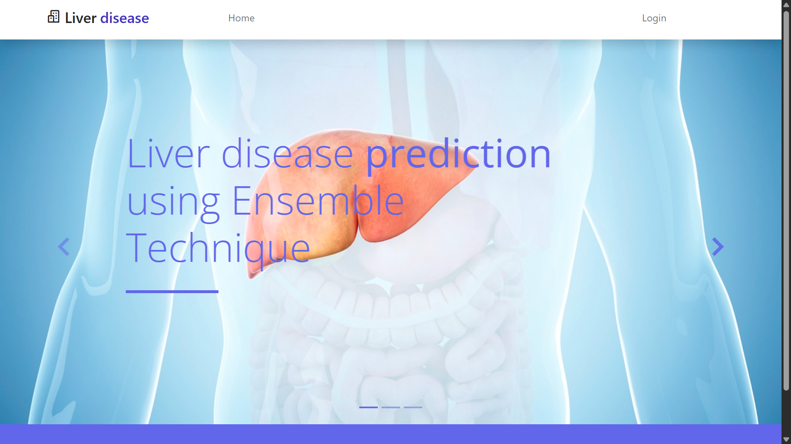
HOME PAGE

Slide 15
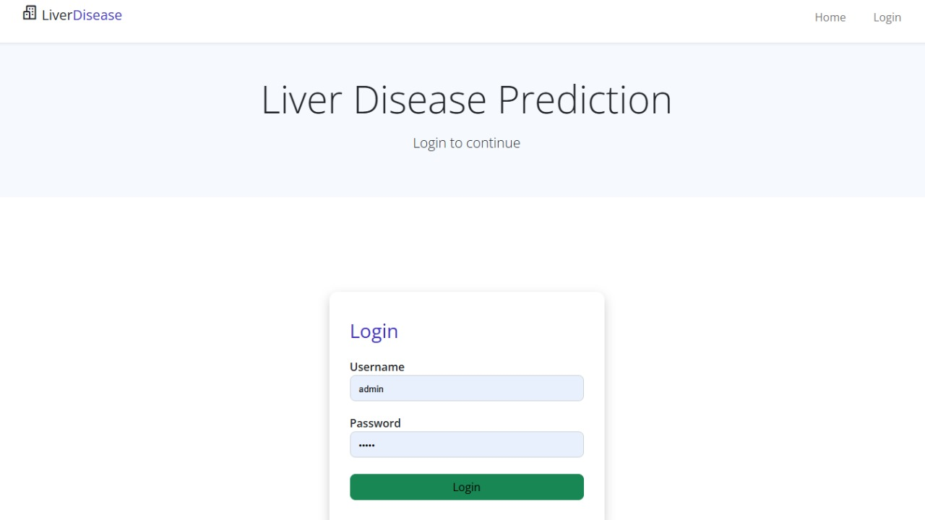
LOGIN PAGE

Slide 16
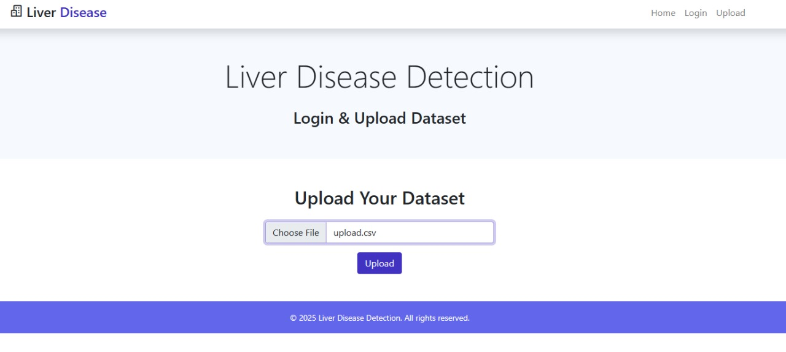
UPLOAD PAGE

Slide 17
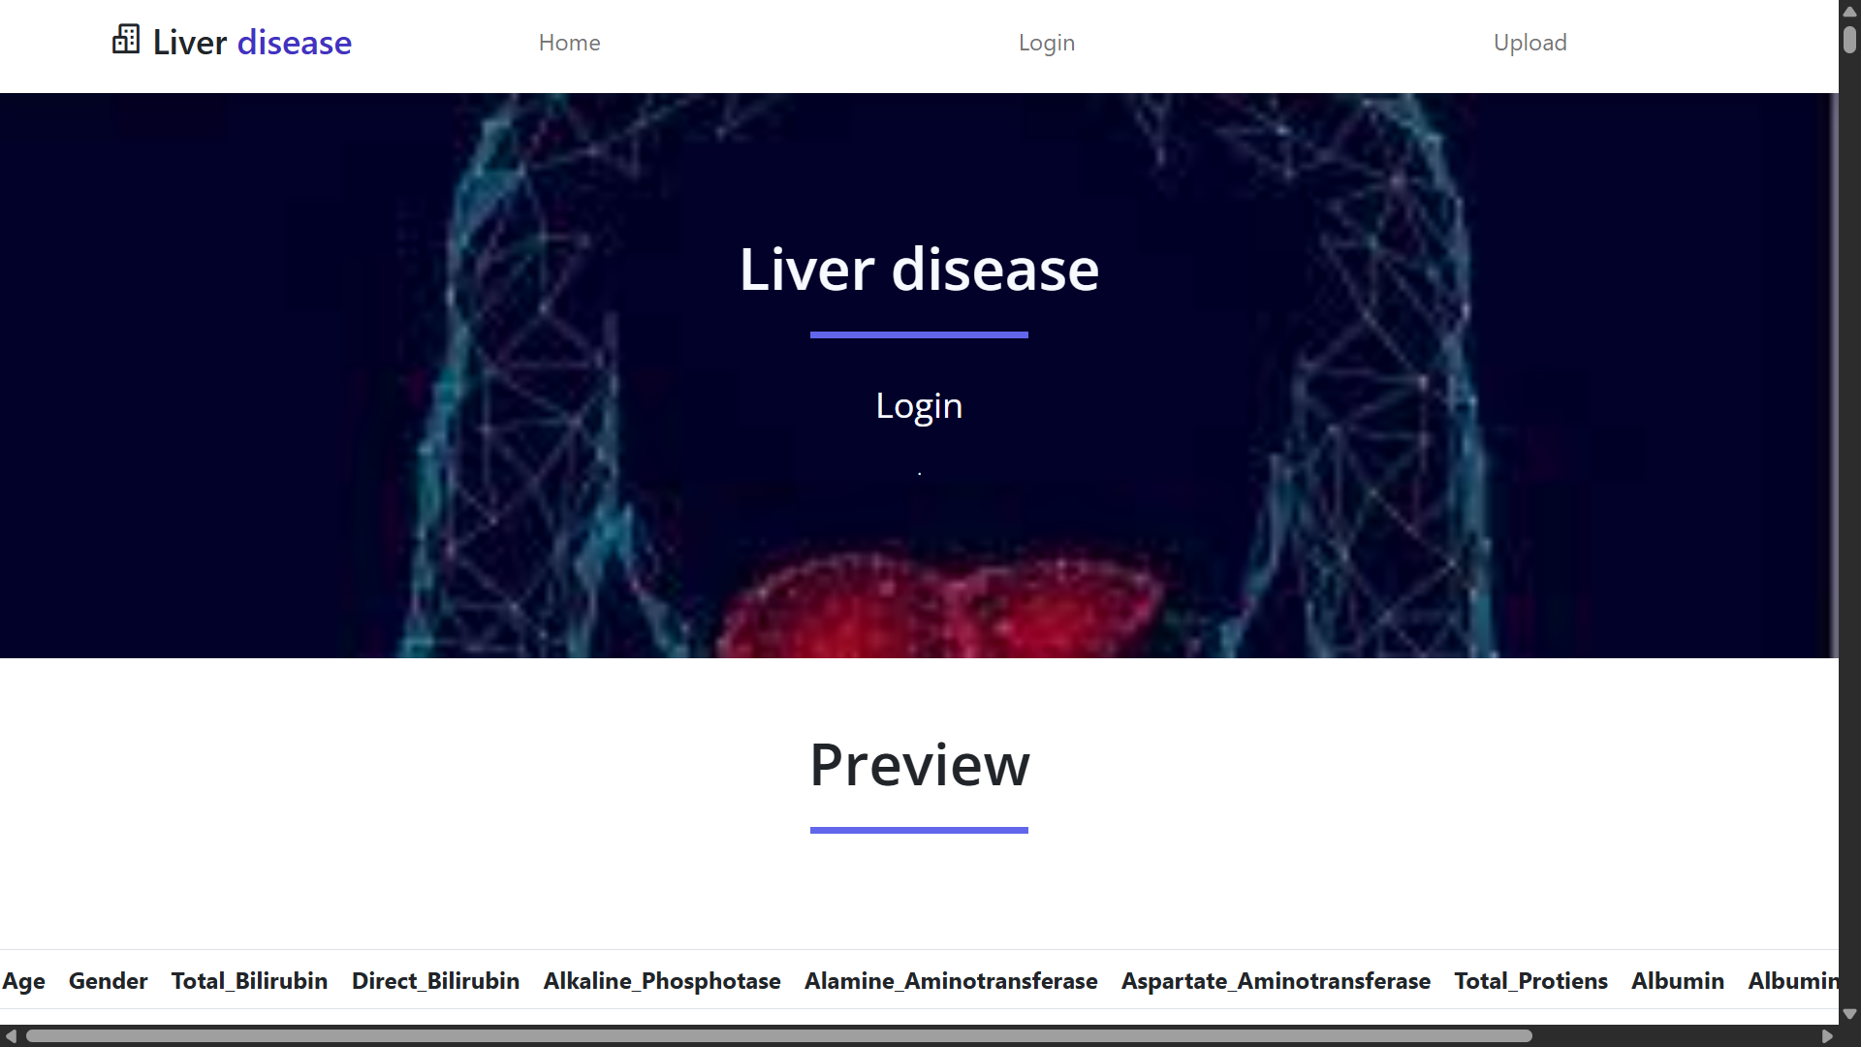
PREVIEW PAGE

Slide 18
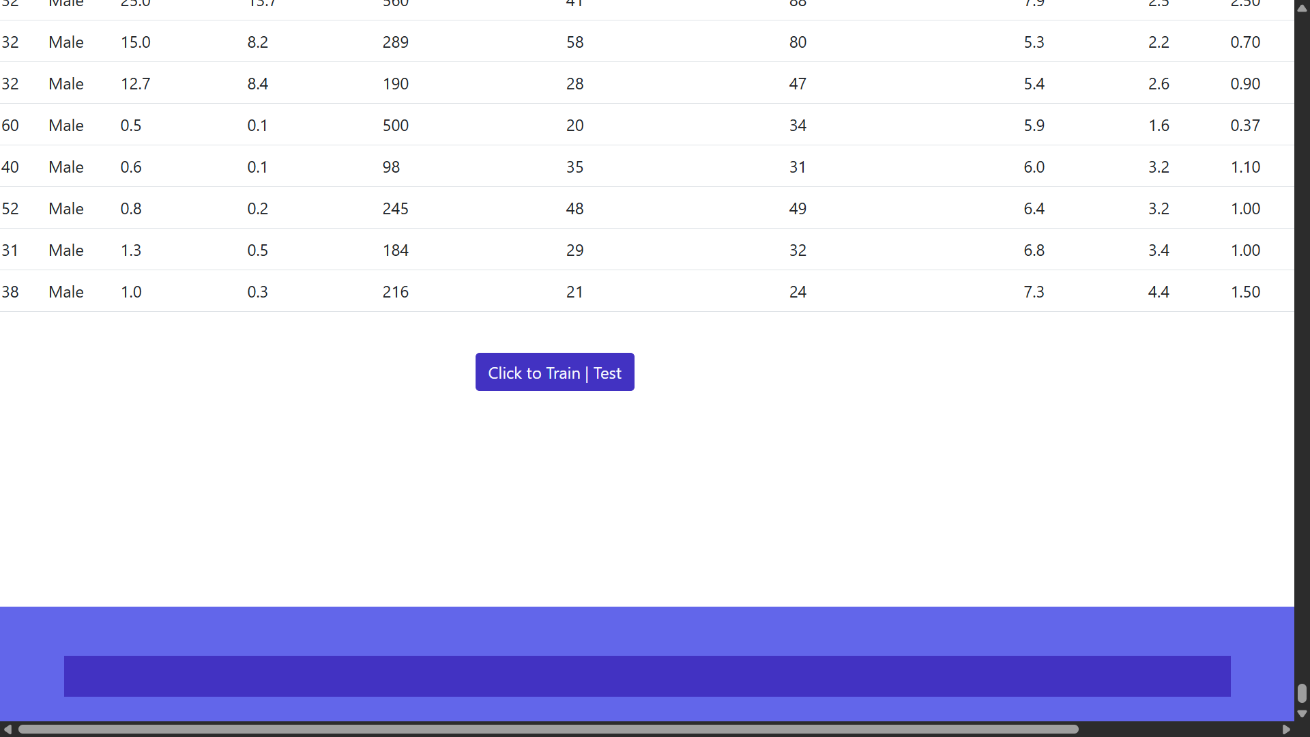
PREVIEW PAGE

Slide 19
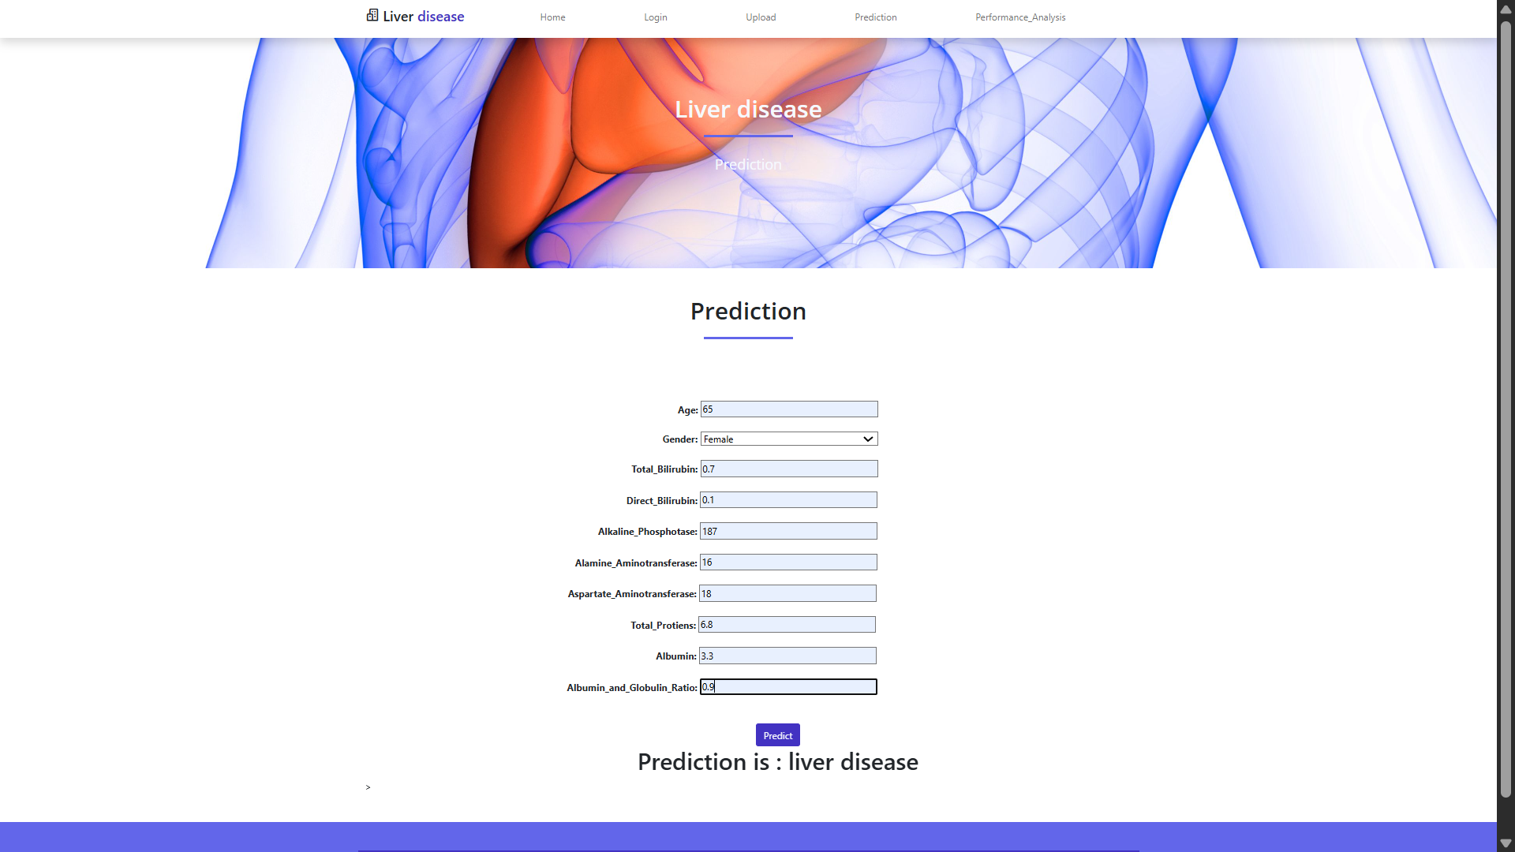
PREDICTION PAGE

Slide 20
PERFORMANCE ANALYSIS
Precision: is a performance metric that measures the accuracy of positive predictions.
In the context of liver disease prediction, precision answers the question:
"Of all the patients predicted to have liver disease, how many actually have it?“
Formula: True Positive (TP)
Precision=------------------------------------------------------------------
True Positive (TP)+False Positive (FP)
​
True Positives (TP):Correctly predicted as having liver disease.
False Positives (FP):Incorrectly predicted as having liver disease (but they don’t actually have it).
Recall: also known as Sensitivity or True Positive Rate,
measures the ability of the model to identify all actual cases of liver disease.
It answers the question:
"Of all the patients who truly have liver disease, how many did the model correctly identify?
Formula: True Positive (TP)​
Recall=-------------------------------------------------------------------------------
True Positive (TP)+False Negative (FN)
False Negatives (FN):who actually have liver disease but were missed by the model.

Slide 21
PERFORMANCE ANALYSIS
Accuracy: is a performance metric that measures the overall correctness of the model.
In the context of liver disease prediction, it answers the question:
"Of all the patients tested, how many were correctly classified as either having liver disease or not?"
Numbers of Correct Predictions
Formula:
Accuracy= --------------------------------------------
Total numbers of Prediction
F1 SCORE: is a performance metric that represents the harmonic mean of Precision and Recall.
It is especially useful when there is an imbalance between classes(e.g., more healthy patients than liver disease patients).
It answers the question:
"How balanced is the model in correctly identifying liver disease cases while minimizing false alarms?“
Formula:
Precision X Recall
F1-score= 2 × ----------------------------------------------------
Precision + Recall

Slide 22
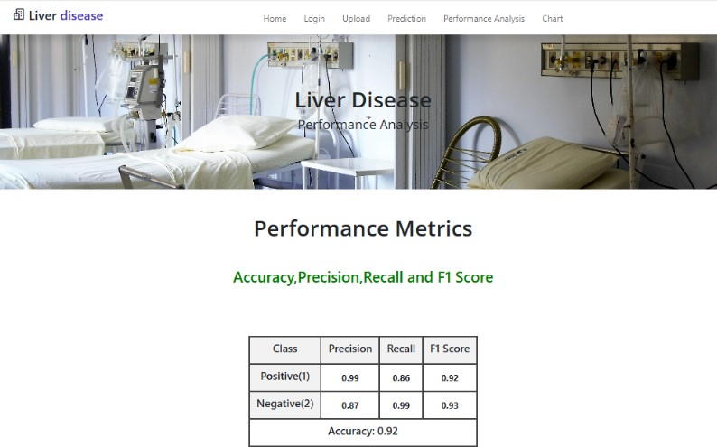
PERFORMANCE ANALYSIS PAGE

Slide 23
CONFUTION MATRIX
A confusion matrix for a binary classification (two classes, e.g., 0 & 1) looks like this:
 | Predicted: Negative | Predicted: Positive
Actual: Negative | True Negative (TN) | False Positive (FP)
Actual: Positive | False Negative (FN) | True Positive (TP)
True Negative → The number of correct negative predictions (Predicted =0,Actual= 0
True Positive → The number of correct positive predictions (Predicted = 1, Actual = 1)
False Positive → The number of incorrect positive predictions (Predicted = 1, Actual = 0)
False Negative → The number of incorrect negative predictions (Predicted = 0, Actual = 1)

Slide 24
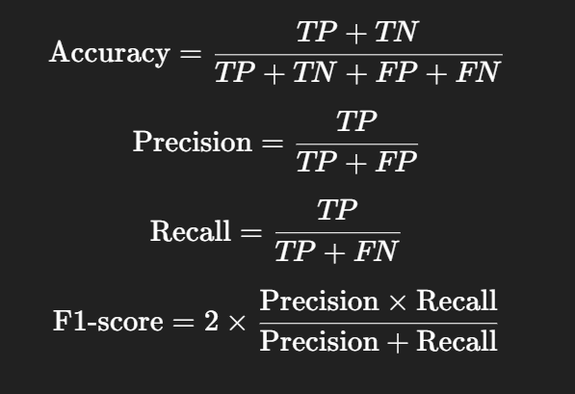
CONFUTION MATRIX
Use the confusion matrix to calculate other metrics:

Slide 25
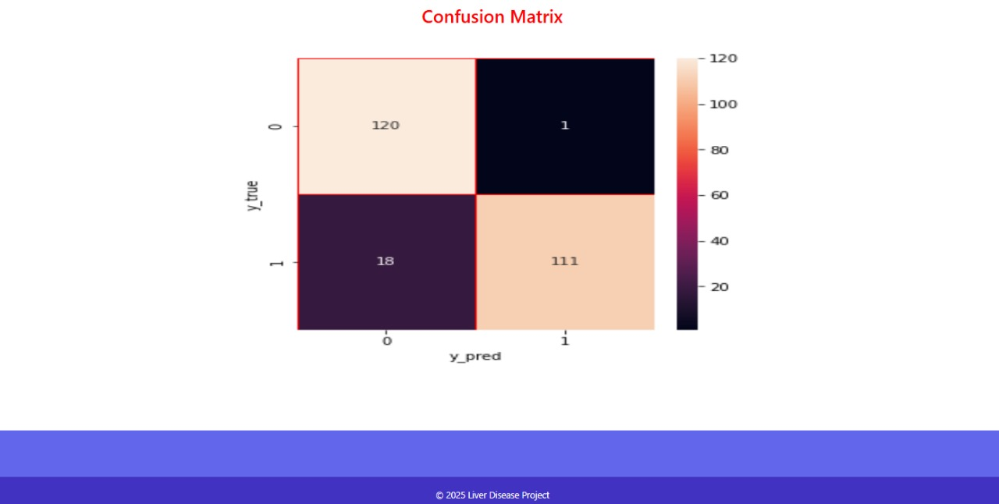
CONFUTION MATRIX

Slide 26
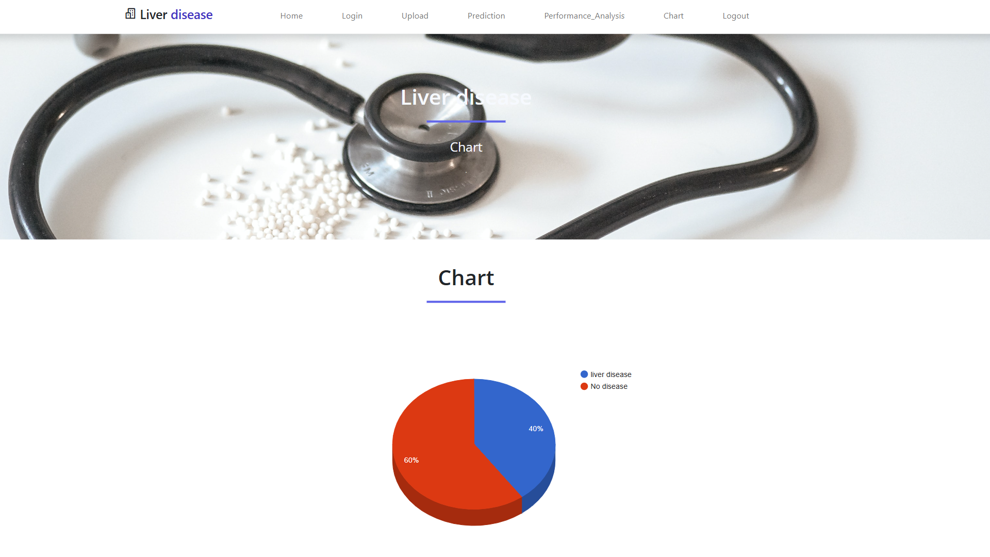
CHART PAGE

Slide 27
ADVANTAGES
High Accuracy: Ensemble methods offer higher predictive accuracy than individual models.
Better Performance: They deliver better predictions and overall performance.
Robustness: Ensembles reduce prediction variance and enhance model reliability.
Improved Generalization: They combine bias and variance for better average performance.
Versatility: Suitable for handling both linear and non-linear data.
Reduced Overfitting/Underfitting: Helps in balancing bias-variance tradeoff effectively.

Slide 28
CONCLUSION:
In conclusion, this project shows that using ensemble techniques like Gradient Boosting and AdaBoost can help predict liver disease more accurately. These methods combine several models to give better results. They reduce errors and improve the performance of the prediction. The results are useful for early detection of liver disease. This can help doctors make better decisions for treatment.

Slide 29
END OF PRESENTATION
Thankyou Everyone !

